Slide 1

Git Gud at Git (Ft. GitHub)
Tyler Hardy
University of Southern Mississippi
Summer Workshop Training Series
August 16, 2018

Slide 2



≠
Notes:
So why do I say Git featuring Github?
Well, that’s because git is not the same thing as GitHub.

Slide 3
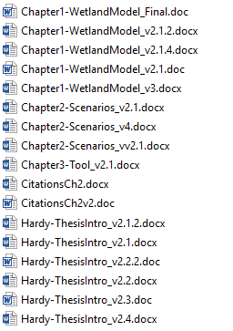
Master
Plot Change
Version Control SOFTWARE
Collaboration (or Not)
Prevents CHAOS
Math
Change
Notes:
Git is version control software – every time you make what is called a commit in git, you save a version of any files included
So if you’ve ever seen something like this….. then you know how painful versioning can get.
And then especially if you are trying to collaborate with someone!
*CLICK*
So this is where version control comes in; it saves a history of changes, with one version of each file.
Anyone familiar with Google Docs’ Revision History should know this, and their rev history actually uses a version control system to store these data.
And even if you’re not collaborating, using version control prevents chaos by giving you the ability to go back in time without pulling out hair.

Slide 4
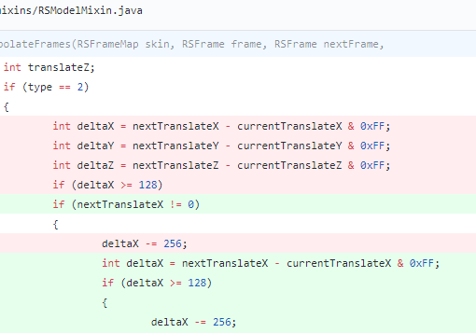

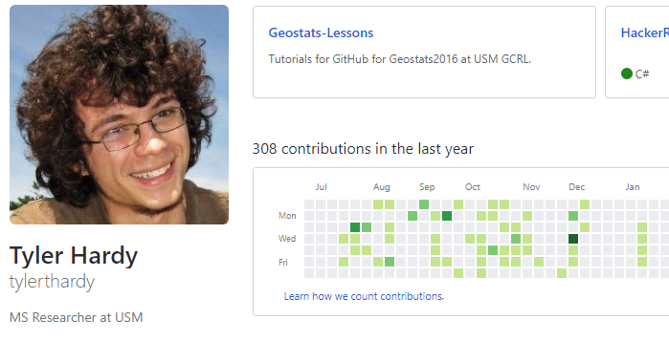
Ft.
Version Control SERVICE
Central ONLINE repository
Upload “git” to GitHub
Programmers’ LinkedIn
Notes:
GitHub is a version control service.

Slide 5
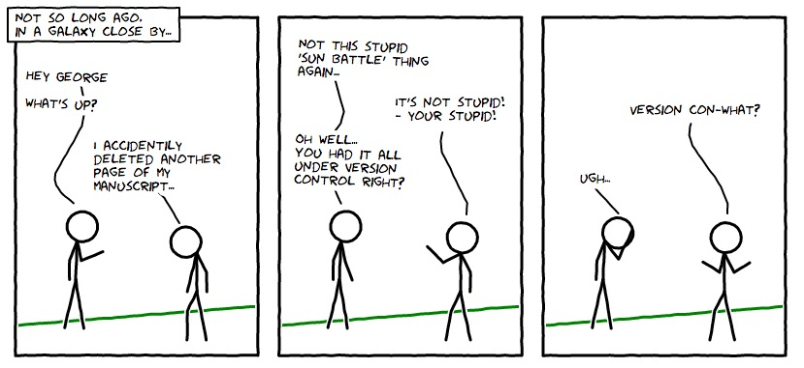
Why?
Recover
Compare
Share

Slide 6


Slide 7
Why?
Recover
Compare
Share

Slide 8
Getting Started
Install git
Register on GitHub
Verify e-mail

Slide 9
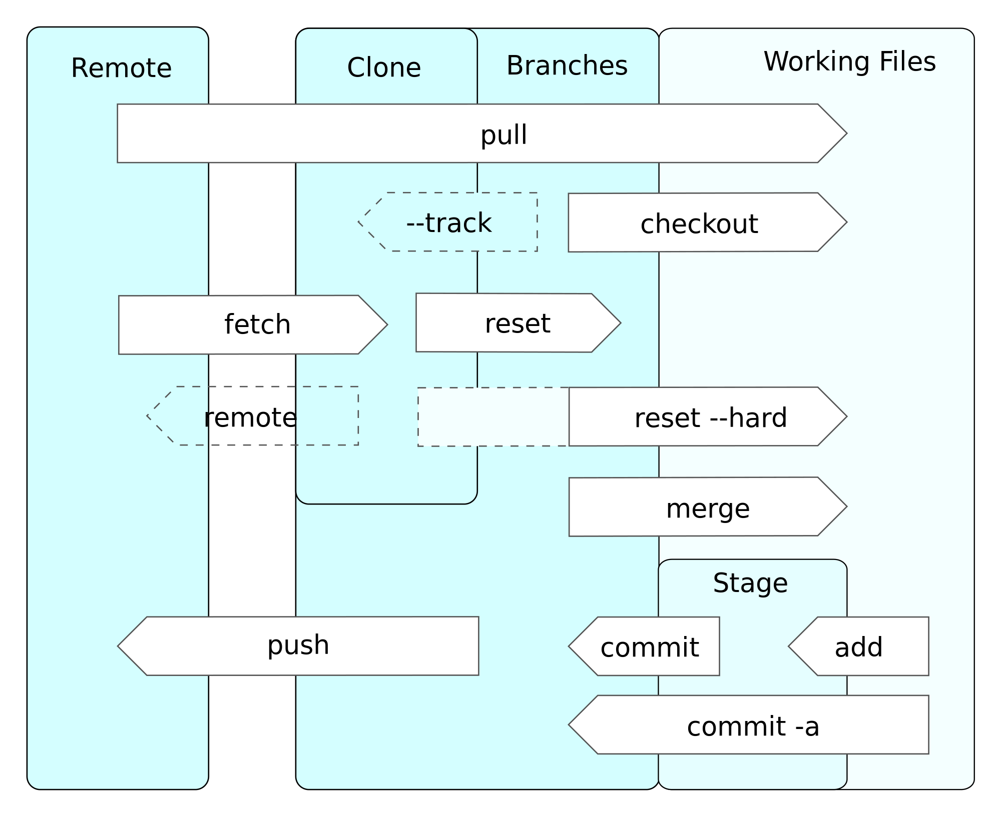
Exercise 1
Create a Repo Clone, Commit, Push
Instructions Found HERE

Slide 10
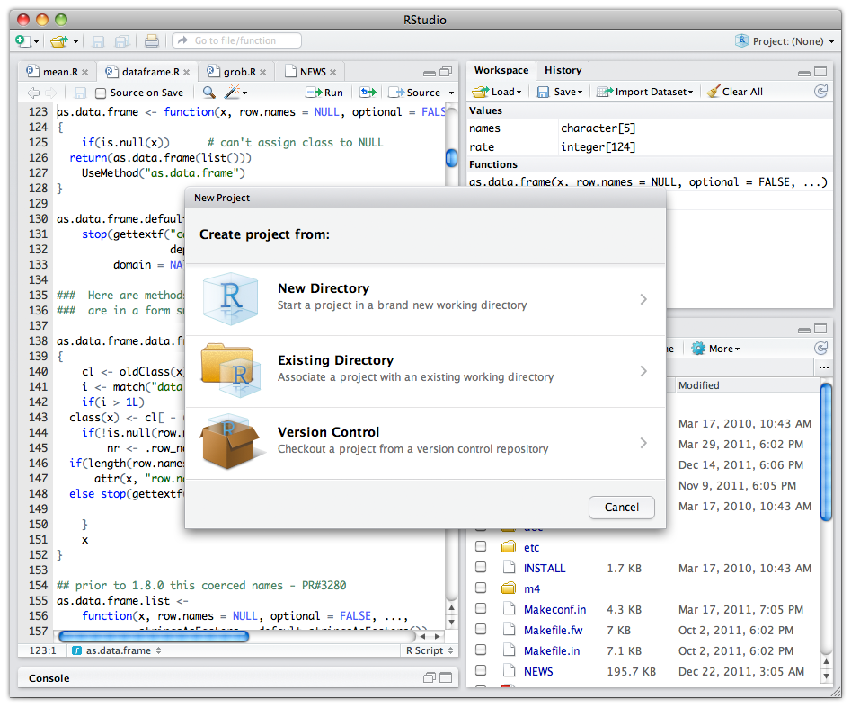
Exercise 2
Git in RStudio!
Instructions Found HERE

Slide 11
Exercise 3
Collaboration
Cloning, Pulling, Reset (Restore)
Instructions Found HERE

Slide 12
